Slide 1
Automate Diagnosis & Consultant(adc)
(changing the way to presenting and detection of any diagnosis.)
PCS23-11
Domain: Full Stack + Machine Learning
Objective
The objective of developing an automated system is to reduce health care costs by reducing physical hospital visits, hospitalizations, and diagnostic testing procedures.
Team members:
Ayush Srivastava
1900290120029
Ankit Yadav 1900290120016
Under the Guidance of
Mr. Harsh Khatter
Assistant Professor Department of Computer Science

Slide 2
INTRODUCTION
The health problem is the gap between acceptable or desirable health status and the present status.
This project is based on real-time implementation as well as more informative and realistic.
It can be highly used in Medical Diagnosis and understanding the different feasibilities of the model.

Slide 3
PROBLEM STATEMENT
In such unprecedented times, with a fragile healthcare infrastructure, the medical facilities for people are scarce and even fewer for people with special needs. The healthcare sector got so preoccupied with Covid-19 cases that people with other ailments didn't even get a chance to avail medical assistance. So, We are here to present a model to mitigate the scarcity of facilities and the lack of medical management.

Slide 4
SOLUTION
Integration of clinical decision support with computer-based patient records could
Reduce medical errors.
Automated Diseases Prediction System.
Doctor Recommendation System
Online Consultation/Appointment with Labs/Doctors.
Path-labs Booking
Decentralized Patient Records
Integrate doctors and patients via an interacting and user-friendly interface so that Patients can easily utilize it in emergency situations.

Slide 5
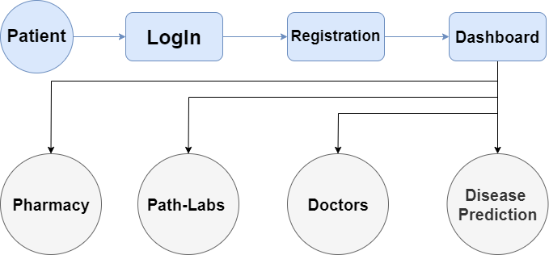
METHODOLOGY

Slide 6
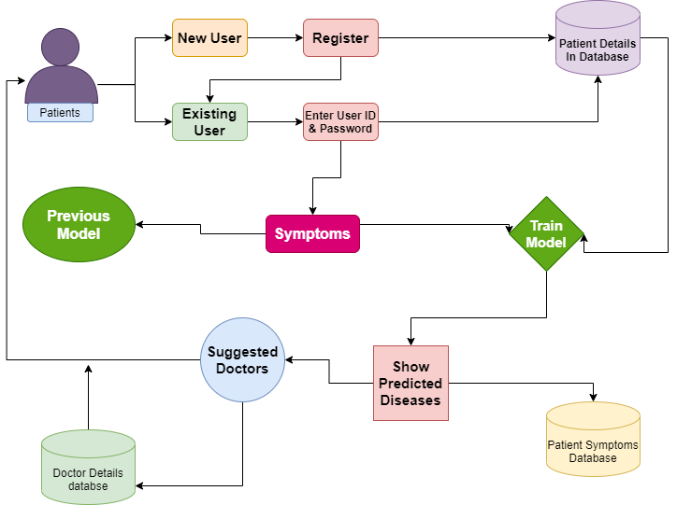
Web DevelopmentModel

Slide 7
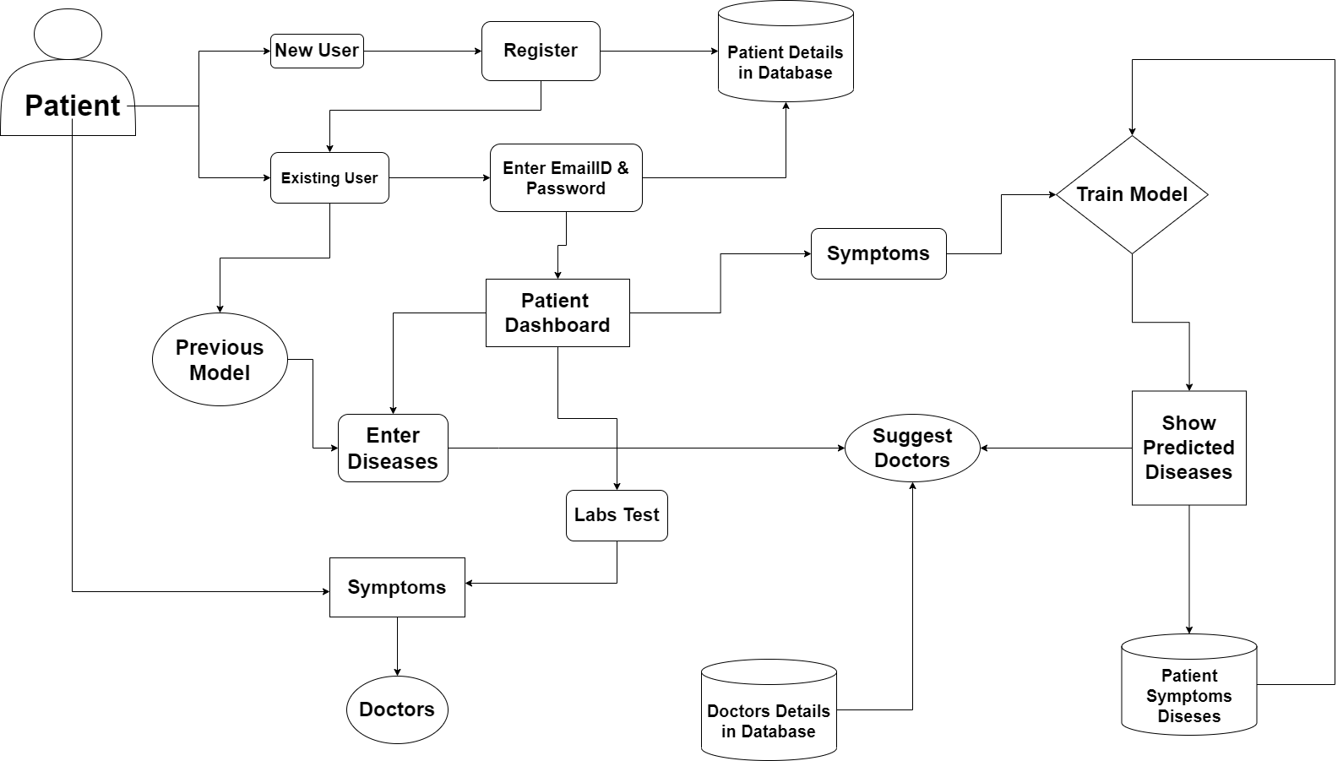

Slide 8
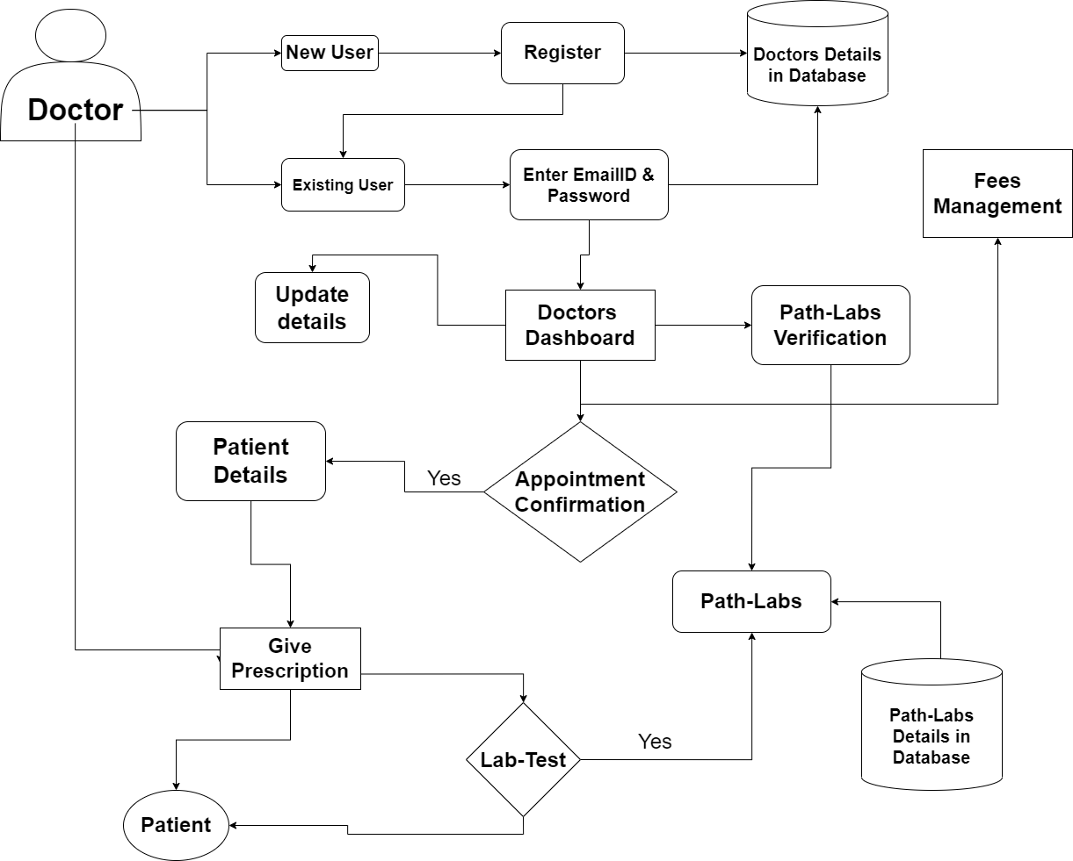

Slide 9


Technology Stack
Web Development
Frontend: HTML, CSS, JavaScript.
Backend: NodeJs, ExpressJs MongoDB.
Machine Learning
Anaconda, Jupyter-Notebook, EDA, NumPy, Pandas, Matplotlib, Pandas, Sklearn, ML & DL Algorithms.

Slide 10
Social Impact Analysis
Integration of clinical decision support with computer-based patient records could reduce medical errors, enhance patient safety.
It deceases unwanted practice variation and improve practice outcome which can help significantly improve the quality of clinical decisions.
Reduce disease identification time and start treatment expeditiously.
Reduce the cost of medical tests & by providing initial diagnostics in time that reduce huge amount of burden on patient’s family.

Slide 11
OUTCOME OF THE PROJECT
Research Paper
Patent

Slide 12
Machine learning-based automated medical diagnosis to enhance healthcare infrastructure.
A sizeable segment of the world's population lacks access to quality healthcare. The success of healthcare ultimately depends on the doctor's skill. In this study, we investigate if this knowledge may be represented as an information corpus, or as data that has been retrieved using data mining methods, particularly the Machine Learning & Deep Learning Model, to make a diagnosis. When the medical diagnosis is made widely available, coverage increase and life quality improve. In order to determine whether inferences about the causes of various diseases can be made from the data, this paper provides an overview of machine learning approaches used in the classification of various diseases. We outline a few of our findings from the trials we ran before offering some suggestions for the future.

